Slide 1

Genetic Algorithm for Tetris AI

Slide 2
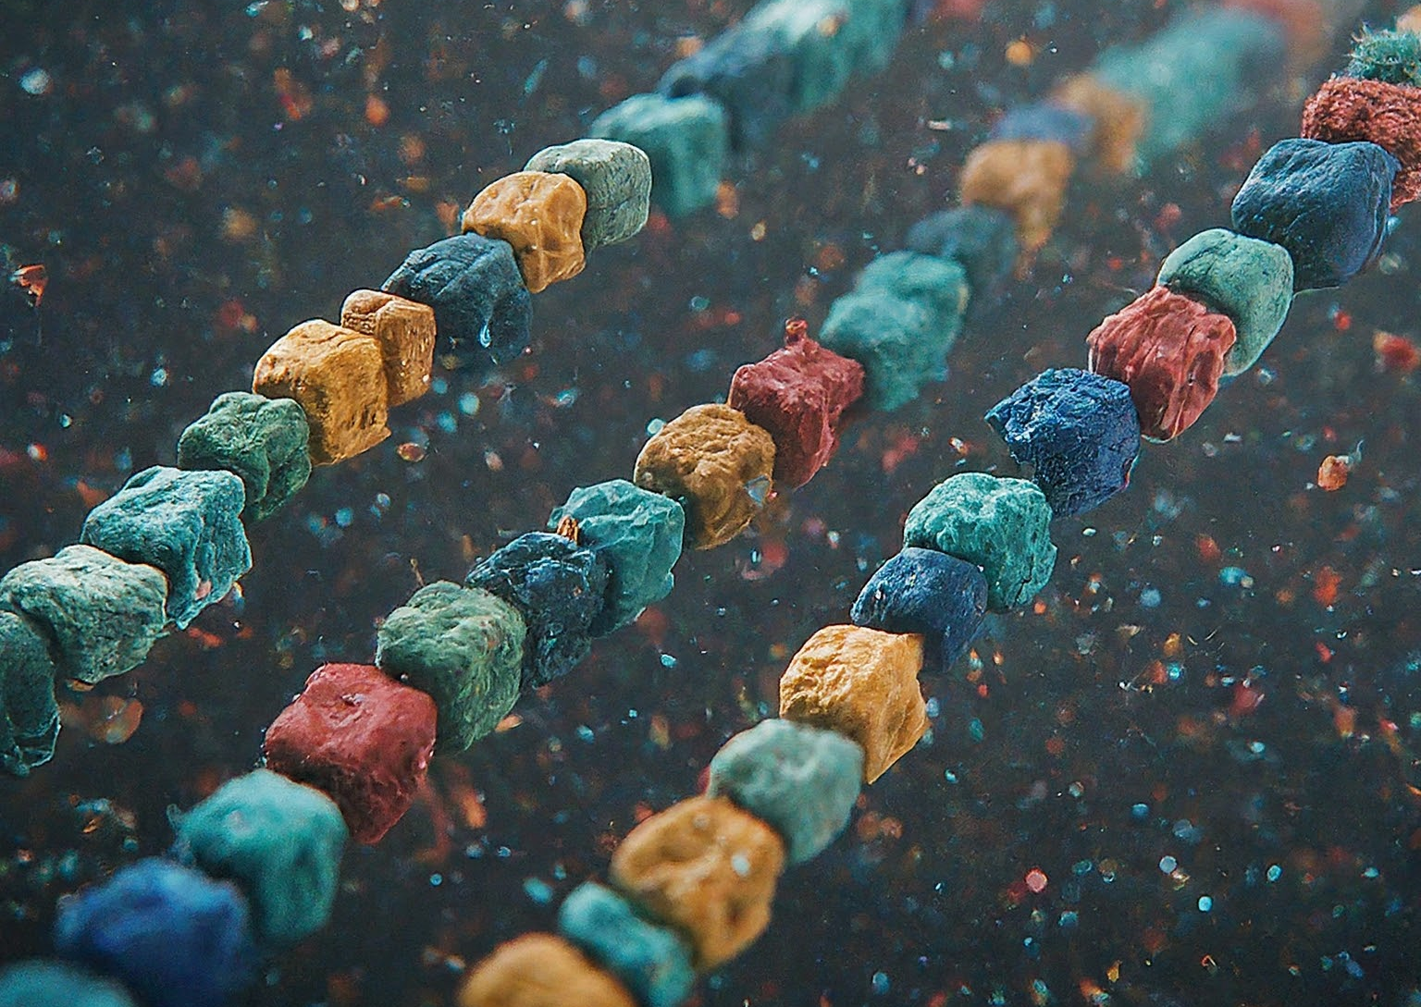
Initializing Chromosomes
initialize_chromosome(num_weights, lb=-10, ub=10):
function initialize_chromosome which is used to create
chromosomes with random weights.
Each chromosome represents a potential solution
(Tetris AI) for the problem.

Slide 3

Calculating Fitness
calculate_fitness(weights, game_state):
function determines how well a chromosome performs (fitness) by simulating the Tetris game with the weights encoded in the chromosome.

Slide 4

Calculating Best Move
calc_best_move(weights, board, piece, show_game=False)
The calc_best_move function is the core of the Tetris AI.
It uses the chromosome weights to evaluate different moves
and select the one that is expected to lead to the highest score.

Slide 5
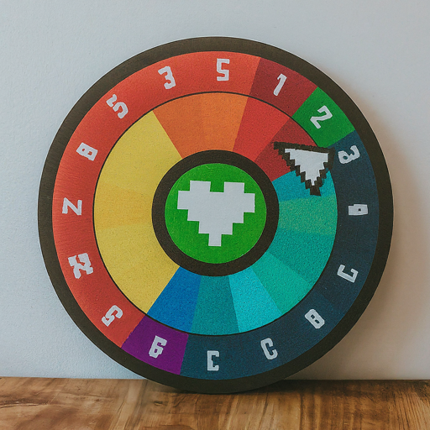
Selection - Roulette Wheel
selection(evaluations, num_selection, type="roulette"):
The selection function plays a crucial role in the genetic algorithm.
It chooses parent chromosomes for reproduction based on their fitness using Roulette Wheel Selection.
Chromosomes with higher fitness scores have a larger chance of being selected, mimicking a roulette wheel with weighted slices.

Slide 6
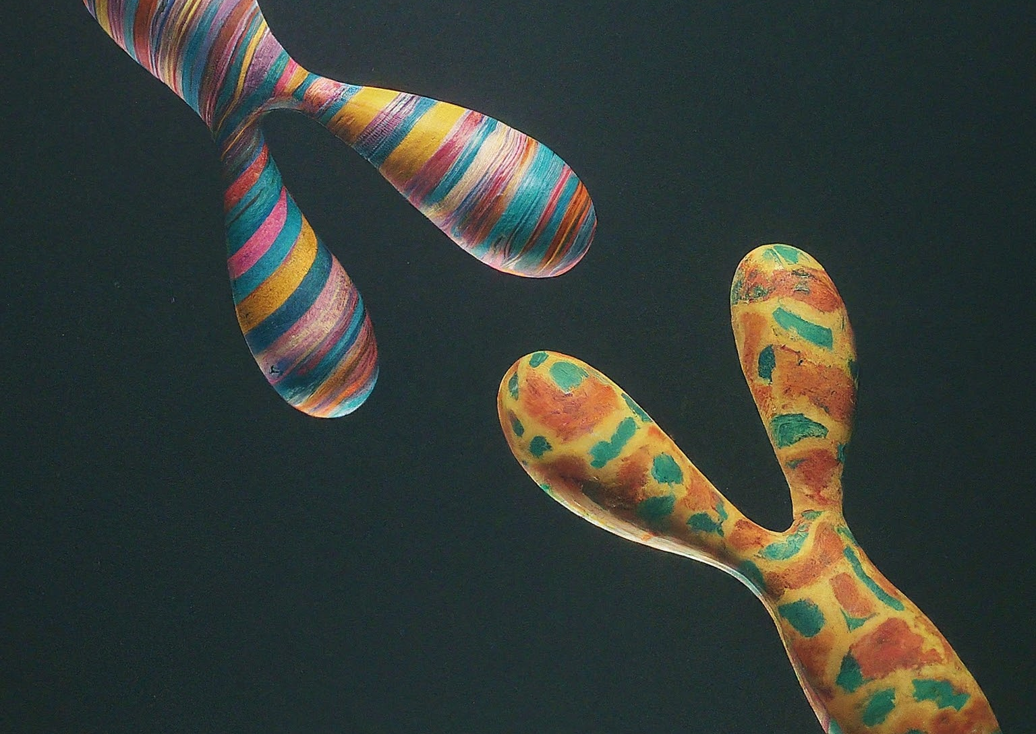
Arithmetic Crossover
_arithmetic_crossover(selected_pop, mutation, cross_rate=0.5, mutation_rate=0.1):
This function performs arithmetic crossover on selected chromosomes.
It combines the weights of parent chromosomes based on a random weight (a) between 0 and 1.
a closer to 0 gives more influence to the first parent, and a closer to 1 favors the second parent.

Slide 7
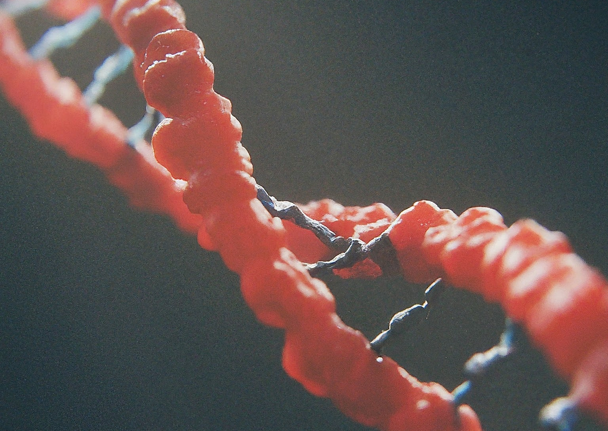
Mutation & Replace
_mutation(chromosome, type, mutation_rate):
This function applies mutations to a chromosome with a certain probability.
replace(old_pop, new_chromo):
This function replaces a portion of the old population with new chromosomes.
The _mutation function introduces randomness into the population by applying mutations to chromosomes.
The replace function guides the evolution process by selecting better chromosomes to be carried over to the next generation.

Slide 8
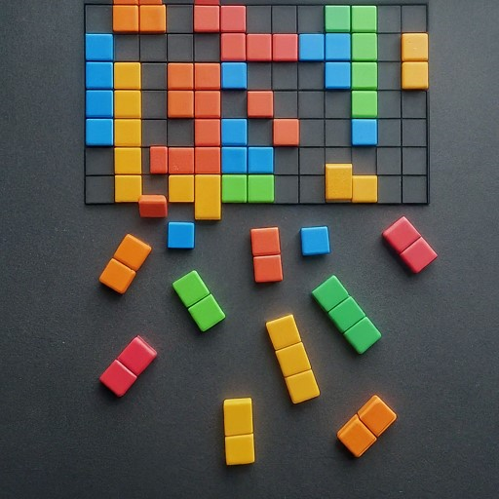
Main Program
Initialization
Loop over Generations
Evolution within Generation
Update Best Chromosome
Store Best Scores
Logging and Saving Results

Slide 9

Conclusion
The genetic algorithm implemented in this project demonstrates the effectiveness of evolutionary algorithms in training AI agents for playing complex games like Tetris.
By iteratively evolving populations of chromosomes, the algorithm is able to discover optimal weights that lead to improved performance in the game.

